Slide 1


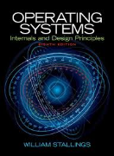
Welcome to
CS 345 Operating Systems
Introduction (01)

Slide 2

CS 345 – Operating Systems

Slide 3
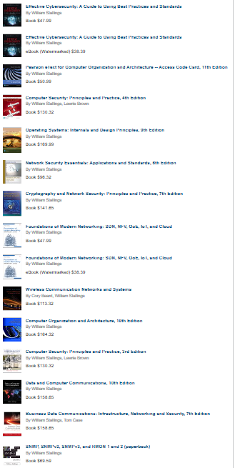

William Stallings
Authored 17 titles, and counting revised editions, a total of 40 books on various aspects of these subjects.
In over 20 years in the field, he has been a technical contributor, technical manager, and an executive with several high-technology firms.
Currently he is an independent consultant whose clients have included computer and networking manufacturers and customers, software development firms, and leading-edge government research institutions.
Bill has designed and implemented both TCP/IP-based and OSI-based protocol suites on a variety of computers and operating systems, ranging from microcomputers to mainframes.
He has received the award for the best Computer Science textbook of the year from the Text and Academic Authors Association three times.
Dr. Stallings received his B.S. in electrical engineering from University of Notre Dame and his PhD in computer science from Massachusetts Institute of Technology.

Slide 4
CS 345 Learning Outcomes
Pre-requisites
CS 224, CS 235, CS 236, CS 240.
Knowledge of C or instructor’s consent.
CS 345 is an introduction to the principles underlying the design and the implementation of contemporary computer operating systems.
At the end of the course, the student should have…
Demonstrated a basic understanding of design and implementation issues of an operating system by implementing a cooperative OS.
Discussed, analyzed, and implemented many of the concepts of process, multithreading, symmetric multiprocessing, and microkernels.
Implemented memory management techniques, including virtual memory.
Programmed various approaches to process scheduling.
Programmed an OS management of files.

Slide 5
Organization and Grading
Weighted contribution to your final grade:
Homework: 10%
Programming Labs: 60%
Midterm Exams: 20%
Presentation (Final): 10%
All exams will be administered by Learning Suite.
A = 93% C = 73%
A- = 90% C- = 70%
B+ = 87% D+ = 67%
B = 83% D = 63%
B- = 80% D- = 60%
C+ = 77% E = below 60%

Slide 6
Homework (10%)
Homework assignments are designed to reinforce class material and help in exam preparation.
Homework is assigned for every 4 or 5 sessions.
Any homework submitted after the due date will lose 50% per week.
Submit home via Learning Suite.
You are welcome and encouraged to discuss the homework with your classmates and others. However, you are to do and submit your own work. Submitting someone's work is considered cheating for which you will receive an E grade for the class and be reported to the Honor Code Office.

Slide 7
Programming Assignments (60%)
Programming assignments can be found on the CS345 web site (http://students.cs.byu.edu/~cs345ta/).
The programming assignments build upon each other.
Programming assignments must be passed off by a TA via a zoom session on a school computer or your personal laptop.
To receive full credit, programming assignments must be completed and passed off with a “Date Modified” timestamp on or before the due date.
NOTE: Timestamps cannot be used for extra credit points and cannot be more than one week delinquent.
Programming assignments submitted after the due date will receive a 50% penalty on portions of the lab not submitted on time.
As an incentive to get your assignments done early, assignments passed off at least one day before the due date (timestamps do not count) with a TA, will receive an additional extra credit point (≈10%).

Slide 8
Programming (continued…)
All six programming assignments must be completed (fully functional) to receive and “A” grade.
Everyone who completes all six programming assignments (regardless of their scores) and passes a final exam (70% or better) will pass the class with at least a “C-” grade.
Any grade points earned on assignments above the allotted percentage may apply to your overall grade.
All assignments MUST BE COMPLETED, PASSED OFF AND SUBMITTED on or before the final day of class.

Slide 9
Presentations (10%)
At the end of the semester, each student (in a small group setting) is given the opportunity to present a specific OS topic with respect to an assigned contemporary operating system.
Your presentation will be peer graded and should be
complete (ie., self-contained, concise, relevant, adequately addressed topic),
insightful (ie., researched, thoughtful, shows effort), and
presented well (ie., materials, slides, handouts, examples, stage presence, well organized, intro/summary).
Your presentation along with submission of your OS source code will be the final exam for the course.

Slide 10
CS 345 Overview
Stalling’s Chapter | # | Project
1: Computer System Overview 2: Operating System Overview | 4 | P1: Shell
3: Process Description and Control 4: Threads | 4 | P2: Tasking
5: Concurrency: ME and Synchronization 6: Concurrency: Deadlock and Starvation | 6 | P3: Jurassic Park
7: Memory Management 8: Virtual memory | 6 | P4: Virtual Memory
9: Uniprocessor Scheduling 10: Multiprocessor and Real-Time Scheduling | 6 | P5: Scheduling
11: I/O Management and Disk Scheduling 12: File Management | 6 | P6: FAT
Student Presentations | 8

Slide 11
Lab Grading
Programming Labs: (60%)
Lab 1: Shell (CLI) – 8%
Lab 2: Tasking – 10%
Lab 3: Jurassic Park – 10%
Lab 4: Virtual Memory – 10%
Lab 5: Scheduling – 6%
Lab 6: FAT – 16%
FAT 1 – 6%
FAT 2 – 10%

Slide 12
OS345 Labs
Lab 1: Shell. Write a Shell (Command Language Interpreter) to parse textual commands entered from the user’s keyboard, malloc argument variables, handle signals, and execute programs directly or as child processes.
Lab 2: Scheduler. Write a five-state task scheduler capable of simultaneously executing up to 128 tasks in a preemptive, prioritized, round-robin manner. Implement binary and counting semaphores and schedule your CLI as its first task with pseudo-interrupt driven character input. Add timer semaphores and tasks to validate your implementation.
Lab 3: Jurassic Park. Write a Jurassic Park simulation where visitors to the park purchase a ticket, wait to take a ride on a park tour car to see the dinosaurs, and then visit the museum and gift shops before leaving the park. Since the park is on a limited budget, drivers must perform double duty when not sleeping by selling tickets and driving the tour cars. Visitors, drivers, cars, park display, and lost visitors' alerts are concurrent tasks.

Slide 13
OS345 Labs
Lab 4: Virtual Memory. Add a Memory Management Unit (MMU) to your OS that translates virtual LC-3 logical addresses to physical addresses in a restricted memory space. Validate your implementation by successfully executing up to 10 LC-3 crawler and/or memory test programs concurrently in 2 frames of physical memory (128 words).
Lab 5: FSS Scheduling. Add a Fair Share Scheduler (FSS) to your OS scheduler to maximize overall CPU utilization while also maximizing interactive performance. Instead of using run queues, implement a “fair” timeline of future task execution.
Lab 6: FAT File Manager. Add a MS-DOS® FAT-12 file manager to your OS that is able to traverse file directories, view file data, and load/execute LC-3 programs from files. Implement creation, access, and modification of FAT-12 files by adding file manager functions and commands that use file system buffering, basic file I/O, file descriptors, and file pointers to modify file allocation tables (FAT), directory structures and cluster chains.

Slide 14
Miscellaneous
Programming Environments
CS Retake Policy
Academic Honesty
TA’s
Help sessions
Office hours
Email communication (proper@cs.byu.edu)
Linux vs Microsoft users
Questions?

Slide 15
Lab 1: Shell
Lab 1: Shell. Write a Shell (Command Language Interpreter) to parse textual commands entered from the user’s keyboard, malloc argument variables, handle signals, and execute programs directly or as child processes.
A shell (Command Language Interpreter) is a task (unit of execution ) that functions as an interface between the user and an Operating System.
A shell interprets textual commands coming either from the user’s keyboard or from a script file and executes the commands either directly or creates a new child process to execute the command.
Download all the project files from class website.
os345.c, os345interrupts.c, os345signals.c os345tasks.c, os345semaphores.c
os345.h, os345config.h, os345signals.h
os345p1.c, os345p2.c, os345p3.c, os345p4.c, os345p5.c, os345p6.c
os345park.c, os345park.h, os345lc3.c, os345lc3.h, os345mmu.c, os345fat.c, os345fat.h
Edit os345config.h (if necessary) to select host OS/IDE/ISA. (Only enable one of the following defines: DOS, GCC, MAC, or NET.)
Compile and execute your OS.

Slide 16
Why Take CS 345?
Senioritis
224/324 Repeat
Love C
Fascinated with OS’s
Concurrency
Why CS 345?

Slide 17
Student Comments…
“345 was the first class I took where I felt motivated and capable (in a CS class) of learning new things quickly. It genuinely was a turning point for me as a student.
“… applied to the Goldman Sachs technology division, and they asked me non-stop about CS 345. Well I got a full-time job offer…”
“… I recently took part in a grueling 3 hour job interview for a local startup company. The coveted prize was a paid internship that came with training for my future career as a software engineer. … Questions were asked about processes/threads, virtual memory, and scheduling, all three of which are key components of the operating systems class on campus.”

Slide 18
Student Comments…
“… OSes are the most used pieces of software on any computer, and being familiar with how they work under the hood is an essential for anyone who wants to have a successful career in software development.”
“… Not all CS classes currently in the program are beneficial to all students' future careers in software development, but I argue that operating systems is actually very useful to all students hoping to develop software professionally. … the OS class an elective ... a great disservice to any CS student hoping to advance a career in industry and will leave him/her to learn the necessary OS material later on in their careers, while others competing for the same jobs will have already learned the material during their undergraduate studies.”

Slide 19
Operating Systems
What is an operating system?
Hard to define precisely, because operating systems arose historically as people needed to solve problems associated with using computers.
How about…
“Software that makes computing power available to users by controlling the hardware.”
“Software executes when nothing else is happening.”
“A collection of software modules including device drivers, libraries, and access routines.”

Slide 20
What Does a Modern OS Do?
Provides Abstractions:
Hardware has low-level physical resources with complicated, idiosyncratic interfaces.
OS provides abstractions that present clean interfaces.
Goal: make computer easier to use.
Examples: Processes, Unbounded Memory, Files, Synchronization and Communication Mechanisms.
Provides Standard Interface:
Goal: portability.
Unix runs on many very different computer systems.

Slide 21
What Does a Modern OS Do?
Mediates Resource Usage:
Goal: allow multiple users to share resources fairly, efficiently, safely and securely.
Examples:
Multiple processes share one processor. (preemptable resource)
Multiple programs share one physical memory (preemptable resource).
Multiple users and files share one disk. (non-preemptable resource)
Multiple programs share a given amount of disk and network bandwidth (preemptable resource).
Consumes Resources:
Solaris takes up about 8 Mbytes physical memory (or about $400).

Slide 22
The Future…
In the future, computers will continue to become physically smaller and more portable.
Operating systems have to deal with issues like disconnected operation and mobility.
Media rich information within the grasp of common people - information with psuedo-real time components like voice and video.
Operating systems will have to adjust to deliver acceptable performance for these new forms of data.

Slide 23
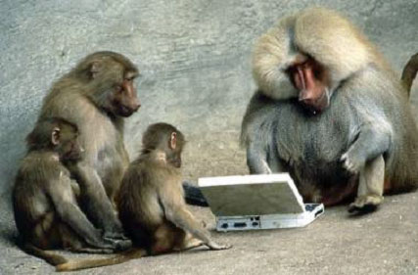

Be Safe

